Slide 1
CSE 424 Computer Architecture Fall 2016 Chapter 1: Introduction, Abstractions and Technology
Adwait Jog (http://adwaitjog.github.io/)
Based on the slides from Mary. J. Irwin (Penn State)
[Adapted from Computer Organization and Design,
5th Edition, Patterson & Hennessy,
Morgan Kaufmann]
Notes:
Combinations to AV system, etc. 0812
Call AV hot line at 8-777-0035

Slide 2
About the Instructor
Adwait Jog, Assistant Professor
Joined W&M in August, 2015
PhD from Penn State 2015, worked at NVIDIA and Intel before
http://adwaitjog.github.io/
adwait@cs.wm.edu (Best way to reach me)
Research Interests in
Computer architecture and systems
Memory and storage systems, emerging technologies
Many-core systems, heterogeneous systems, core design
Accelerators (e.g., GPUs)
Interconnects
New Architectures: Quantum and DNA Architectures
…
Your turn to introduce yourself.
Complete Quiz-1 on Blackboard by Sept 1, 23:00hrs
Interested in developing high-performance, energy-efficient and scalable systems at low cost & complexity

Slide 3
Course Administration
Instructor: Adwait Jog (adwait@cs.wm.edu)
111 McGL, Department of Computer Science
Office Hours: TR – 4pm to 5:30pm or by appointment
TA: Mohamed Ibrahim (maibrahim@email.wm.edu)
101B McGL, Department of Computer Science
Office Hours: By appointment
Class timings:
CS 424/524 – TR @11:00AM to 12:20PM (ISC, 2280)
Class resources/help:
http://adwaitjog.github.io/teach/comp_arch_cs424_f16.html
Lecture slides and other material via Blackboard
Piazza is set-up for online discussions.

Slide 4
Textbooks and Resources
Required Textbook
Computer Organization and Design, Patterson & Hennessey (P&H)
5th Edition (Make sure you have this edition)
Optional Zybooks
http://www.zyBooks.com (Code: WMCSCI424-524JogFall2016)
https://vimeo.com/135692064 (See this video for more details)
I may use this book for some in-class activities, however, you do not have to buy this.
Resources
Some assignments will also have simulation-based component.
Access to a computer with remote access to lab machine is necessary
Check the course website for more details.

Slide 5
Grading Information – CS 424
Homework (40%)
Around 8 sets. Some will have simulation-based component. Some HWs will carry more points.
Please submit electronically (no hard copies) in PDF format via Blackboard by 23:00 hrs. on the due date.
You may use MS-word or Latex to typeset your answers. You can also scan and submit your hand-written HWs, but handwriting should be legible.
Midterm Exam (25%)
October 13th, Thursday, in-class
Final Exam (25%)
December 14th, 2:00 to 5:00pm, in our regular classroom
Class participation and In-class/Blackboard Quizzes (10%)
Optional Research Project; Talk to me if you are interested.
If you are considering grad school later on, it would be good to involve in research early.

Slide 6
Grading Information – CS 524
Homework (30%)
Around 8 sets. Some will have simulation-based component. Some HWs will carry more points.
Please submit electronically (no hard copies) in PDF format via Blackboard by 23:00 hrs. on the due date.
You may use MS-word or Latex to typeset your answers. You can also scan and submit your hand-written HWs, but handwriting should be legible.
Midterm Exam (20%)
October 13th, Thursday, In-class
Final Exam (20%)
December 14th, 2:00 to 5:00pm, in our regular classroom
Class participation and In-class/Online Quizzes (10%)
Required Research Project (20%) : Two written progress reports each due on the day of Midterm and Final Exam.

Slide 7
Policies
You are expected to attend all lectures. You are responsible for all materials covered in lectures.
All exams are closed textbook and closed notes. No electronic devices are allowed.
No collaboration whatsoever is allowed on exams and quizzes.
All HWs need to be completed on your own, unless otherwise specified (I may allow collaboration in some HWs – more details to follow).
Collaboration is encouraged on the research projects.
Submission Deadlines are HARD. However, we do have a late/miss policy
Late HWs are accepted with 20% penalty for each day they are late by.
If you miss an exam or quiz, you will get zero on that. The lowest score on quizzes will be dropped.
Exceptions will be handled case by case and will only be considered under a university-approved condition, with written proof.
Grading-related Questions
Please contact the TA first. If issues are not resolved, then contact the instructor (cc TA).

Slide 8
Academic Integrity and Accommodations
The university and department policies against academic dishonesty will be strictly enforced.
Students are required to follow the Honor System of the College of William and Mary as described in the student Handbook.
It is the policy of The College of William and Mary to accommodate students with disabilities and qualifying diagnosed conditions in accordance with federal and state laws. Any student who feels s/he may need an accommodation based on the impact of a learning, psychiatric, physical, or chronic health diagnosis should contact Student Accessibility Services staff at 757-221-2509 or at sas@wm.edu to determine if accommodations are warranted and to obtain an official letter of accommodation. For more information, please see here http://www.wm.edu/offices/deanofstudents/services/studentaccessibilityservices/

Slide 9
Reminder: Website, Blackboard, and Piazza
Tentative schedule (will keep changing regularly based on the progress of the course) and other details are posted on the course website.
http://adwaitjog.github.io/teach/comp_arch_cs424_f16.html
Lecture slides, homework assignments, and other course materials will be posted on Blackboard.
Course announcements/reminders will be delivered via piazza. Also, you may use this forum to ask general clarification or conceptual questions regarding homework, quizzes, exams etc.
Please keep checking all forums regularly for the latest information.
Notes:
if you have never used a Unix system - you have that to learn as well!

Slide 10
Computers in our daily life

Slide 11

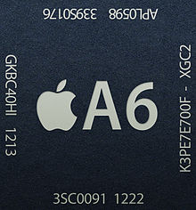



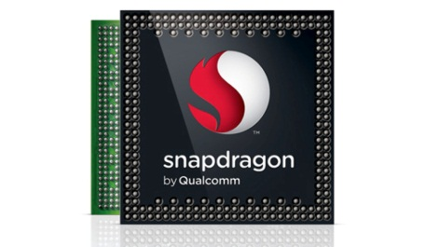

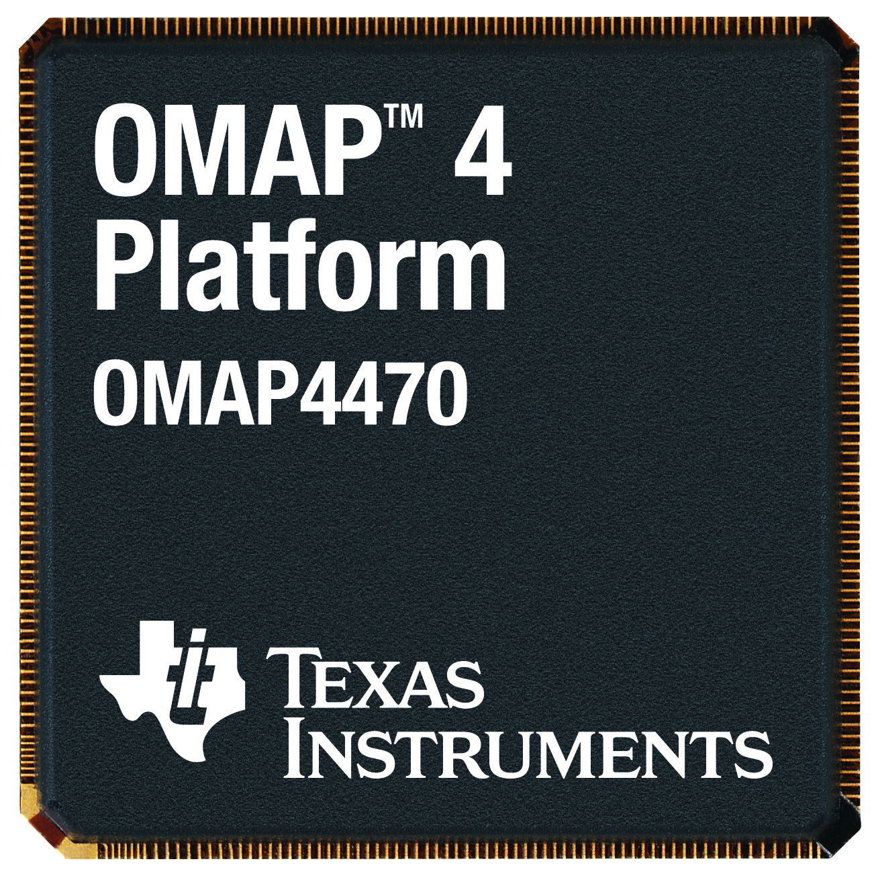
Just after you wake up …
Smart Phones
Keeping you “connected” all the time!

Slide 12

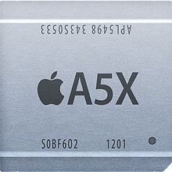
In schools . . .
TABLETS

Slide 13
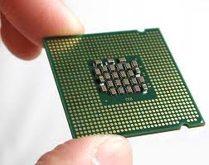


During work . . .
LAPTOPS

Slide 14





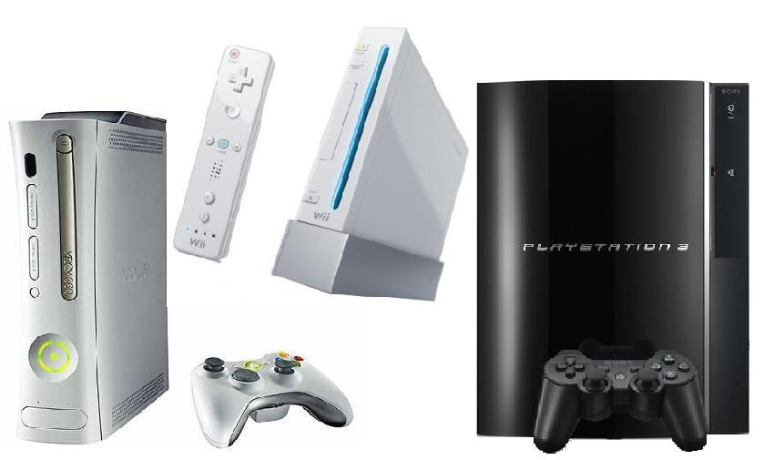


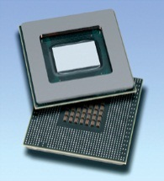
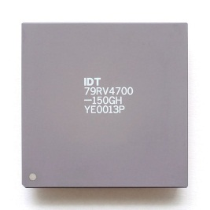
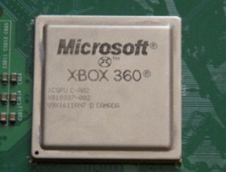

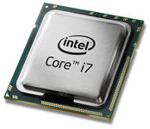
At home . . .
TV Sets & CONSOLES
DESKTOPS & other Entertainment
Notes:
TV – MIPS and atom
Bluray players – MIPS
Xbox 360 – Microsoft XCGPU
Playstation 3 – Sony Toshiba IBM (STI) Cell

Slide 15
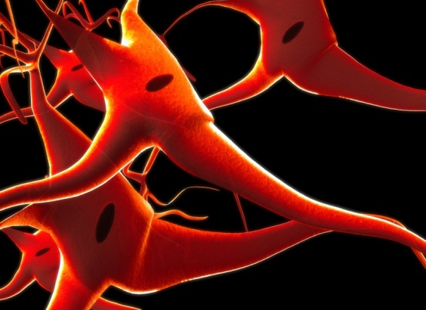



And… other places
HELPS UNDERSTAND UNIVERSE
BACKEND OF “Google”
&
many others
ENABLING
Scientific COMPUTING
&
BREAKTHROUGHS

Slide 16
Where did all this start ?

Slide 17
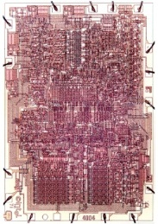
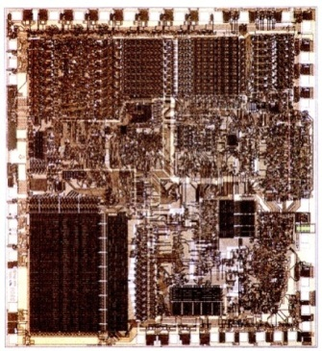
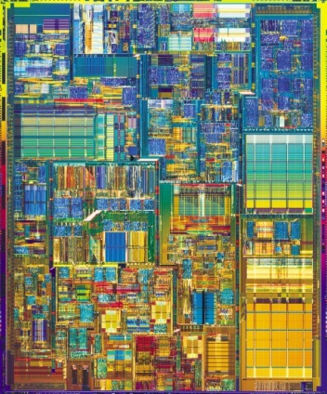
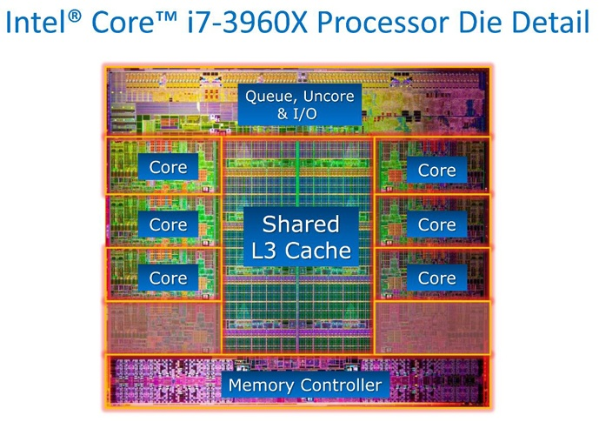
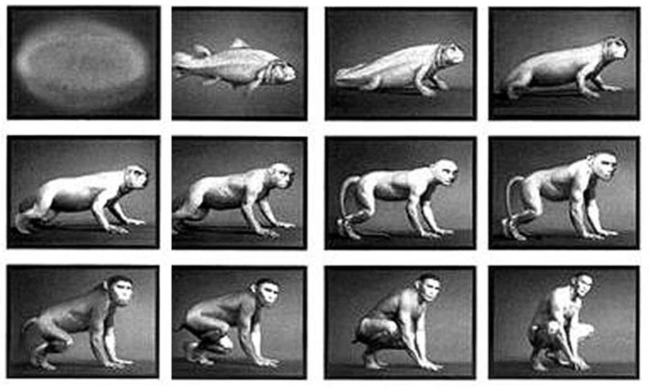

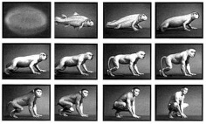

Evolution of Intel Microprocessors
Evolution
Intel 4004,
1971
1 core,
no cache
23K transistors
Intel 8088,
1978
1 core,
no cache
29K transistors
Intel Pentium 4,
2000
1 core
256 KB L2 cache
42M transistors
Intel Sandy Bridge,
2011
6 cores
15 MB L3 cache
2270M transistors
What’s now?

Slide 18
Intel Core i7-6700K Processor, 2016
1.7 billion transistors, 14 nm process, die size 122 mm²
“Skylake”
Notes:
image source probably Intel, available at many places

Slide 19
Computer Organization and Design
This course is all about how computers work
But what do we mean by a computer?
Different types: embedded, laptop, desktop, server, supercomputer
Different uses: robotics, graphics, finance, genomics,…
Different manufacturers: Intel, IBM, AMD, ARM, Freescale, Fujitsu, TI, Sun (Oracle) , MIPS, NEC, …
Different underlying technologies and different costs !
Best way to learn:
Focus on a specific instance and learn how it works
While learning general principles and historical perspectives

Slide 20
Why Learn This Stuff?
You want to call yourself a “computer scientist/engineer”
You need to make a purchasing decision or offer “expert” advice
You want to build HW/SW people use (so you need to deliver performance at low cost within a power budget)
Both hardware and software affect performance
The algorithm (CSCI 241/303) determines number of source-level instructions
The language/compiler/architecture (CSCI 312&442, CSCI 304&424) determine the number of machine-level instructions
The processor/memory (CSCI 304&424) determine how fast machine-level instructions are executed

Slide 21
How Do the Pieces Fit Together?
CSCI 301, 303, 421, 427
Software/Applications
Operating
System
CSCI 444
CSCI 312/442
Compiler
Firmware
Instruction Set
Architecture
Memory
system
Processor
I/O system
Network
CSCI 304 & 424
CSCI 434
Datapath & Control
Digital Design
Courses related to Computer Engineering
Circuit Design
Coordination of many levels of abstraction
Under a rapidly changing set of forces
Design, measurement, and evaluation
Notes:
For lecture

Slide 22
What You Should Know (e.g., say from 304)
Create, assemble, run, debug programs in an assembly language
MIPS preferred
Basic logic design & machine organization
logical minimization, FSMs, component design
processor, memory, I/O
Create, compile, and run C/C++ programs
Create, organize, and edit files and run programs on Unix/Linux

Slide 23
Course Content
Memory hierarchy and design, CPU design, pipelining, multiprocessor architecture.
“This course will introduce students to the architecture-level design issues of a computer system. They will apply their knowledge of digital logic design to explore the high-level interaction of the individual computer system hardware components. Concepts of sequential and parallel architecture including the interaction of different memory components, their layout and placement, communication among multiple processors, effects of pipelining, and performance issues, will be covered. Students will apply these concepts by studying and evaluating the merits and demerits of selected computer system architectures.”
To learn what determines the capabilities and performance of computer systems and to understand the interactions between the computer’s architecture and its software so that future software designers (compiler writers, operating system designers, database programmers, application programmers, …) can achieve the best cost-performance trade-offs and so that future computer architects understand the effects of their design choices on software.

Slide 24
Review: Some Basic Definitions
Kilobyte – 2¹⁰ or 1,024 bytes
Megabyte– 2²⁰ or 1,048,576 bytes
sometimes “rounded” to 10⁶ or 1,000,000 bytes
Gigabyte – 2³⁰ or 1,073,741,824 bytes
sometimes rounded to 10⁹ or 1,000,000,000 bytes
Terabyte – 2⁴⁰ or 1,099,511,627,776 bytes
sometimes rounded to 10¹² or 1,000,000,000,000 bytes
Petabyte – 2⁵⁰ or 1024 terabytes
sometimes rounded to 10¹⁵ or 1,000,000,000,000,000 bytes
Exabyte – 2⁶⁰ or 1024 petabytes
Sometimes rounded to 10¹⁸ or 1,000,000,000,000,000,000 bytes

Slide 25
Below the Program
Applications software
Systems software
Hardware
System software
Operating system – supervising program that interfaces the user’s program with the hardware (e.g., Linux, MacOS, Windows)
Handles basic input and output operations
Manages storage (disk) and memory (virtual memory)
Schedules tasks and provides for protected sharing of hardware resources (OS memory space)
Compiler – translate programs written in a high-level language (HLL, e.g., C) to machine code

Slide 26
Below the Program
High-level language program (in C)
swap (int v[], int k)
(int temp;
temp = v[k];
v[k] = v[k+1];
v[k+1] = temp;
)
Assembly language program (for MIPS)
swap: sll $2, $5, 2
add $2, $4, $2
lw $15, 0($2)
lw $16, 4($2)
sw $16, 0($2)
sw $15, 4($2)
jr $31
Machine (object, binary) code (for MIPS)
000000 00000 00101 0001000010000000
000000 00100 00010 0001000000100000
. . .
one-to-many
C compiler
one-to-one
assembler
Notes:
Computer only understands zeros and ones – instructions of 0’s and 1’s
Early programmers found representing machine instructions in a symbolic notation – assembly language
And developed programs that translate from assembler to machine code
Eventually, programmers found working even in assembler too tedious so migrated to higher-level languages and developed compilers that would translate from the higher-level languages to assembler

Slide 27
Below the Program
High-level language program (in C)
swap (int v[], int k)
. . .
Assembly language program (for MIPS)
swap: sll $2, $5, 2
add $2, $4, $2
lw $15, 0($2)
lw $16, 4($2)
sw $16, 0($2)
sw $15, 4($2)
jr $31
Machine (object) code (for MIPS)
000000 00000 00101 0001000010000000
000000 00100 00010 0001000000100000
100011 00010 01111 0000000000000000
100011 00010 10000 0000000000000100
101011 00010 10000 0000000000000000
101011 00010 01111 0000000000000100
000000 11111 00000 0000000000001000
C compiler
assembler
Notes:
For lecture:
Sll: shift left logical

Slide 28
Input Device Inputs Object Code
000000 00000 00101 0001000010000000
000000 00100 00010 0001000000100000
100011 00010 01111 0000000000000000
100011 00010 10000 0000000000000100
101011 00010 10000 0000000000000000
101011 00010 01111 0000000000000100
000000 11111 00000 0000000000001000
Processor
Devices
Network
Control
Memory
Input
Datapath
Output
Notes:
1. The input devices bring the object code and input data from the outside world into the computer.

Slide 29
Object Code Stored in Memory
Stored Program Computer
Processor
Memory
Devices
000000 00000 00101 0001000010000000
000000 00100 00010 0001000000100000
100011 00010 01111 0000000000000000
100011 00010 10000 0000000000000100
101011 00010 10000 0000000000000000
101011 00010 01111 0000000000000100
000000 11111 00000 0000000000001000
Network
Control
Input
Datapath
Output
Notes:
2. These data are kept in the computer’s memory until ...
Note that memory holds both INSTRUCTIONS and DATA and you can’t tell the difference. They are both just 32 bit strings of zeros and ones.

Slide 30
Processor Fetches an Instruction
Processor fetches an instruction from memory
Processor
Memory
Devices
000000 00000 00101 0001000010000000
000000 00100 00010 0001000000100000
100011 00010 01111 0000000000000000
100011 00010 10000 0000000000000100
101011 00010 10000 0000000000000000
101011 00010 01111 0000000000000100
000000 11111 00000 0000000000001000
Network
Control
Input
Datapath
Output
Notes:
3. The processor request and process them.

Slide 31
Control Decodes the Instruction
Control decodes the instruction to determine what to execute
Processor
Devices
Network
Control
000000 00100 00010 0001000000100000
Memory
Input
Datapath
Output
Notes:
3. The processor control decodes the instruction in order to figure out what to tell the datapath to do

Slide 32
Datapath Executes the Instruction
Datapath executes the instruction as directed by control
Processor
Devices
Network
Control
000000 00100 00010 0001000000100000
Memory
Input
Datapath
contents Reg #4 ADD contents Reg #2
results put in Reg #2
Output
Notes:
4. The operation of the datapath is controlled by the processor’s controller.

Slide 33
What Happens Next?
Processor
Memory
Devices
000000 00000 00101 0001000010000000
000000 00100 00010 0001000000100000
100011 00010 01111 0000000000000000
100011 00010 10000 0000000000000100
101011 00010 10000 0000000000000000
101011 00010 01111 0000000000000100
000000 11111 00000 0000000000001000
Network
Control
Input
Datapath
Output
Notes:
For handout
3. What happens next (next instruction is fetched/how to tell where that instruction is located in memory/…)

Slide 34
What Happens Next?
Processor fetches the next instruction from memory
Processor
Memory
Devices
000000 00000 00101 0001000010000000
000000 00100 00010 0001000000100000
100011 00010 01111 0000000000000000
100011 00010 10000 0000000000000100
101011 00010 10000 0000000000000000
101011 00010 01111 0000000000000100
000000 11111 00000 0000000000001000
Network
Control
Input
Datapath
Output
Fetch
How does it know which location in memory to fetch from next?
Exec
Decode
Notes:
For lecture
3. What happens next (next instruction is fetched/how to tell where that instruction is located in memory/…)

Slide 35
Processor Organization
Control needs to have circuitry to
Datapath needs to have circuitry to
Notes:
For handout

Slide 36
Processor Organization
Control needs to have circuitry to
Decide which is the next instruction and input it from memory
Decode the instruction
Issue signals that control the way information flows between datapath components
Control what operations the datapath’s functional units perform
Datapath needs to have circuitry to
Execute instructions - functional units (e.g., adder) and storage locations (e.g., register file)
Interconnect the functional units so that the instructions can be executed as required
Load data from and store data to memory
What location does it load from and store to?
Notes:
For lecture

Slide 37
Output Data Stored in Memory
At program completion the data to be output resides in memory
Processor
Memory
Devices
Network
Control
Input
00000100010100000000000000000000
00000000010011110000000000000100
00000011111000000000000000001000
Datapath
Output
Notes:
5. The data to be output are kept in the computer’s memory until ...

Slide 38
Output Device Outputs Data
Processor
Devices
Network
Control
Memory
Input
Datapath
Output
00000100010100000000000000000000
00000000010011110000000000000100
00000011111000000000000000001000
Notes:
6. The output device outputs the data in the memory to the output medium.

Slide 39
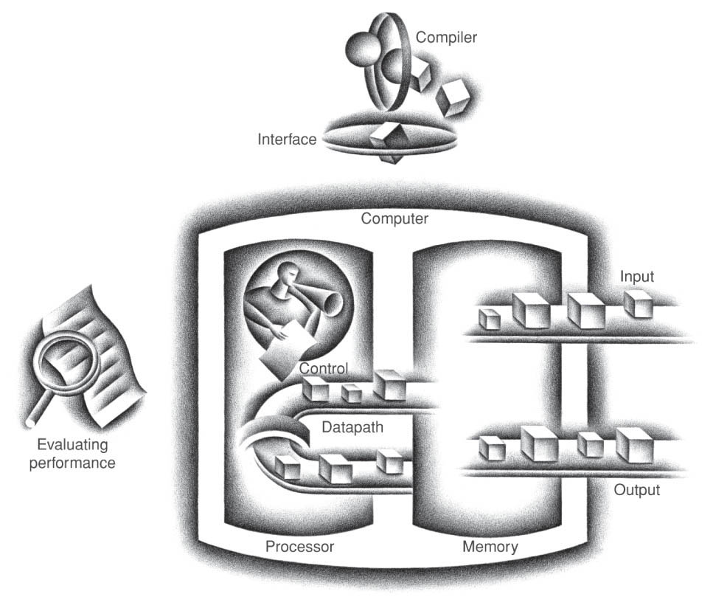
In Summary
Input/output includes
User-interface devices (Display, keyboard, mouse)
Storage devices (Hard disk, CD/DVD, flash)
Network adapters (For communicating with other computers)
datapath + control = processor (CPU)

Slide 40
The Key To It All
Represent instructions as bits, and numbers as bits, and then ...
Interpret bits as instructions or numbers, according to the appropriate context.
The fine print – if it’s possible to misinterpret the bits, so arbitrary data can be taken as instructions, then your system is insecure, and it will be hacked.

Slide 41
Abstractions
Abstraction helps us deal with complexity
hides lower-level detail
layers of abstraction – application-level, system-level (software), system-level (hardware)
Instruction set architecture (ISA)
those parts of the processor visible to the programmer
the hardware/software interface
Application binary interface (ABI)
the ISA plus the system software interface
Implementation
the details underlying an interface
You can change an implementation without changing the interface, if the interface is well-designed.
Notes:
Abstraction does not eliminate complexity, but masks it or transfers it.
There must be a conservation law here, somewhere.

Slide 42
Instruction Set Architecture (ISA)
ISA, or simply architecture – an abstract interface between the hardware and the lowest level software. It encompasses all the information necessary to write a machine language program that will run correctly, including instructions, registers, memory access, I/O, …
ISA = programmer-visible components, instructions and protocols
Using this level of abstraction enables implementations of varying cost and performance to run identical software
The combination of the basic instruction set (the ISA) and the operating system interface is called the application binary interface (ABI)
ABI – The user portion of the instruction set plus the operating system interfaces used by application programmers. Defines a standard for binary portability across computers.
Notes:
PH Sec. 1.3
Protocol = a well-defined sequence of instructions and events, usually used for communication between components.
For example, a function-call and function-return interface is a protocol.

Slide 43
MIPS-32 ISA
Instruction Categories
Computational
Load/Store
Jump and Branch
Floating Point
coprocessor
Memory Management
Special
Registers
R0 - R31
PC
HI
LO
3 Instruction Formats: all 32 bits wide
op
rs
rt
rd
sa
funct
R format
op
rs
rt
immediate
I format
op
jump target
J format
Notes:
Lecture:
MIPS originally meant “Microprocessor without Interlocked Pipelined Stages”.
It is a little endian, word addressable, 3-address, fixed-length ISA.
Called a LOAD and STORE architecture since only load and store can access memory.
All other instructions use registers for operands.

Slide 44
Translation of Programs – it’s all relative
Compiler and assembler
High-level to low-level language translation
The first C++ compiler translated C++ to C, and relied on an existing C compiler to translate to assembly language
Most compilers now translate to an intermediate machine- independent form, and rely on a code-generator to translate that to assembly language
Processor and memory
Hardware executes only the lowest-level language programs, binary
Some processors, notably those executing an x86 ISA, actually translate the external complex ISA to an internal simpler ISA that is never directly visible to the programmer

Slide 45
Advantages of Higher-Level Languages
Higher-level languages
Allow programmers to think in a more natural language for their intended use
Improve programmer productivity – more understandable code that is easier to debug, validate, update and maintain
Allow programs to be independent of the computer on which they are developed
compilers and assemblers can translate high-level language programs to the binary instructions of any machine
Encourage use of optimizing compilers that produce very efficient assembly code optimized for the target machine
As a result, very little programming is done today directly at the assembler level
But, if you want to understand how the world really works ...
Notes:
PH Sec. 1.2
The downside of the final bullet is that very few programmers actually understand, in a deep way, what happens when their programs run.

Slide 46
Understanding Performance
Input data, output data
Determine the “volume” and nature of information, in and out
Algorithm
Determine the number of operations executed
Programming language, compiler, instruction set architecture
Determine the number of machine instructions executed per operation
Processor and memory system
Determine how fast the instructions are executed
I/O system (including the OS)
Determine how fast the I/O operations are executed, and when

Slide 47
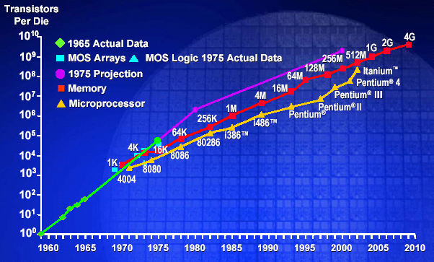
Moore’s Law: 2X transistors / “2 years”
In 1965, Intel’s Gordon Moore predicted that the number of transistors that can be integrated on single chip would double about every two years
feature size
&
die size
Notes:
Rock's Law
The cost of capital equipment to build semiconductors will double every four years.
Arthur Rock organized the money to start Intel in 1968; he invented the term "venture capital".

Slide 48
Technology Scaling Road Map (ITRS)
Year | 2008 | 2010 | 2012 | 2014 | 2016
Feature size (nm) | 45 | 32 | 22 | 18 | 10
Intg. Capacity (BT) | 1.5 | 3 | 6 | 12 | 24
Fun facts about 45nm transistors
30 million can fit on the head of a pin
You could fit more than 2,000 across the width of a human hair
If car prices had fallen at the same rate as the price of a single transistor has since 1968, a new car today would cost about 1 cent
Notes:
International Technology Roadmap for Semiconductors http://www.itrs.net/Links/2011ITRS/Home2011.htm
Transistor count in ITRS is in Functions/chip at introduction (in Mtransistors), so doesn’t include transistors in the caches. To avoid having this discussion I just left tran count as BT and made the numbers consistent with the Poluson numbers a few slides later.

Slide 49
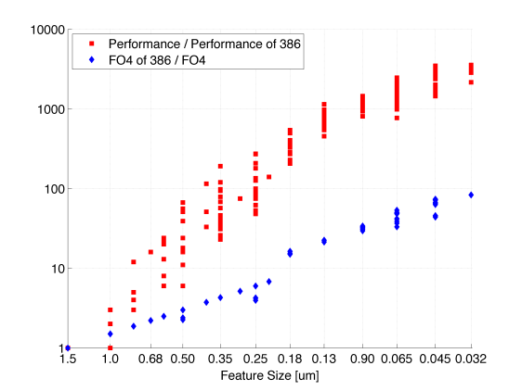
Technology + Architecture
Architecture
Technology
Danowitz et al., CACM 04/2012, Figure 1
0.09

Slide 50
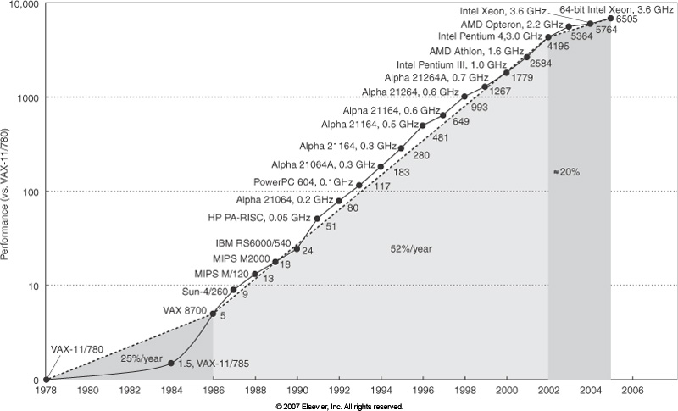
Growth in Processor Performance (SPECint)
Limits on power, available ILP, memory latencies
Technology + advancements in architectures
Technology driven
Notes:
From 1980 to 2000 – performance was seven times faster than what would have been possible with just technology (including improved circuit design) – due to architectural innovations

Slide 51
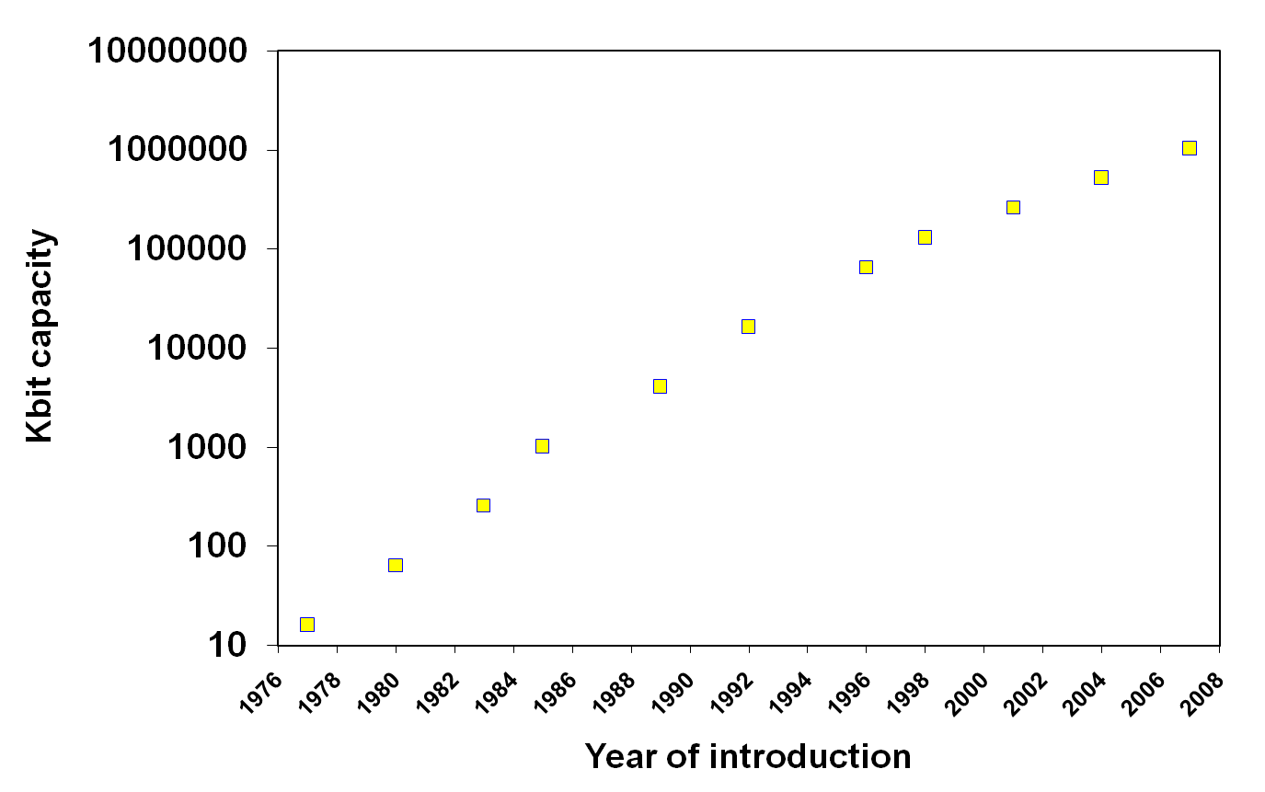
Another Example of Moore’s Law Impact
DRAM capacity growth over 3 decades
1G
256M
64M
512M
128M
4M
16M
1M
64K
256K
16K
Notes:
Memories have quadrupled capacity every 3 years (up until 1996) – a 60% increase per year for 20 years. Now is doubling in capacity every two to three years.

Slide 52
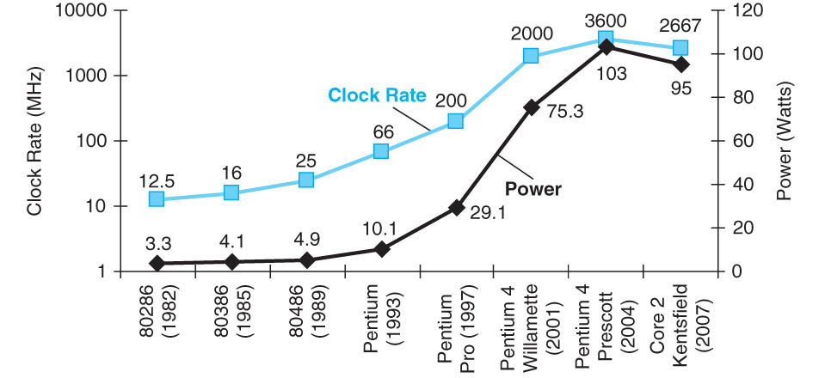
But What Happened to Clock Rates and Why?
Clock rates hit a “power wall”
In CMOS IC technology
???
5V → 1.25V
x288
Notes:
Numbers at the bottom are for the 286 -> Prescott, ??? = x31 (increase in power from the chart)
FIGURE 1.15 Clock rate and Power for Intel x86 microprocessors over eight generations and 25 years. The Pentium 4 made a dramatic jump in clock rate and power but less so in performance. The Prescott thermal problems led to the abandonment of the Pentium 4 line. The Core 2 line reverts to a simpler pipeline with lower clock rates and multiple processors per chip.
Packaging issues for laptop and desktop PC set the “power” limit at 100 Watts.

Slide 53
Reducing Power
Suppose a new CPU has
95% of the capacitive load of the previous generation
10% voltage reduction, the same frequency
We have hit the power wall
We can’t reduce the supply voltage much further or the capacitive load
We can’t remove more heat without new cooling technologies (e.g., liquid cooled)
How can we increase the performance while lowering (or keeping the same) clock rate?

Slide 54
A Sea Change is at Hand
The power challenge has forced a change in the design of microprocessors
Since 2002 the rate of improvement in the response time of programs on desktop computers has slowed from a factor of 1.5 per year to less than a factor of 1.2 per year
Almost all desktop and server companies are shipping microprocessors with multiple processors – cores – per chip
Product | AMD Barcelona | Intel Nehalem | IBM Power 6 | Sun Niagara 2
Cores per chip | 4 | 4 | 2 | 8
Clock rate | 2.5 GHz | ~2.5 GHz? | 4.7 GHz | 1.4 GHz
Power | 120 W | ~100 W? | ~100 W? | 94 W
Plan of record is to double the number of cores per chip per generation (about every two years)
Notes:
Multicore issues
Hard for programmers to write explicitly parallel programs - task scheduling with load balancing and minimal communication and synchronization overhead.

Slide 55
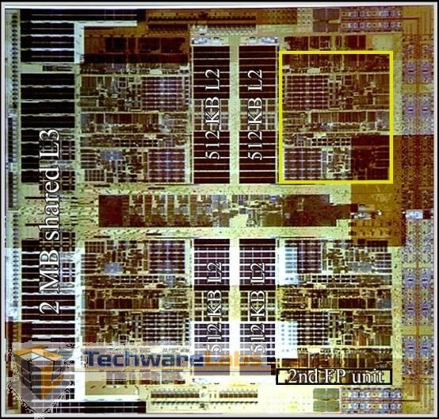
E.g., AMD’s Barcelona Multicore Chip
Four out-of-order cores on one chip
1.9 GHz clock rate
65nm technology
Three levels of caches (L1, L2, L3) on chip
Integrated Northbridge
Core 1
512KB L2
Core 2
512KB L2
2MB shared L3 Cache
Northbridge
512KB L2
Core 3
512KB L2
Core 4
http://www.techwarelabs.com/reviews/processors/barcelona/

Slide 56
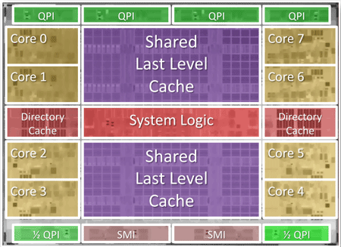
E.g., Intel’s 8 core Poulson
1st major redesign of the Itanium architecture since 2002 - 32nm technology, 3.1 billion transistors, 8 cores, 32MBs of L3 cache, 1Q12, TDP of 170W
Courtesy, Intel ®
Notes:
Intel claims that Itanium is a four billion dollar business and more than 80% of world's top 100 companies utilize Itanium.
http://www.engadget.com/2011/08/22/intel-talks-up-next-gen-itanium-32nm-8-core-poulson/

Slide 57
Multi-core Performance Issues
Private L1 caches, private or shared L2, L3, Lx caches?
Best performance depends upon the applications and how much information they “share” in the cache, or how much they conflict in the cache
Contention for port(s) to off-chip DRAM
Requires explicitly parallel programming (multiple (parallel) threads for one application)
Compare with instruction level parallelism (ILP) where the hardware executes multiple instructions at once
Hidden from the programmer
Parallel programming for performance is hard to do
Load balancing across cores
Cache sharing/contention, contention for DRAM controller(s)
Have to optimize for thread communication and synchronization
Notes:
Hard for programmers to write explicitly parallel programs - task scheduling with load balancing and minimal communication and synchronization overhead.

Slide 58
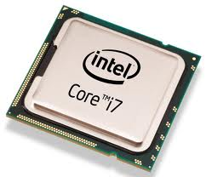
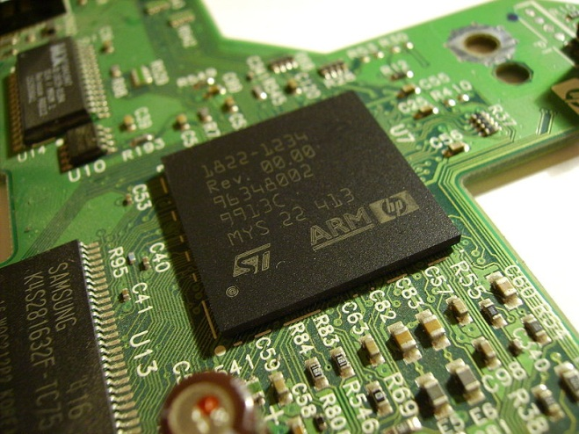
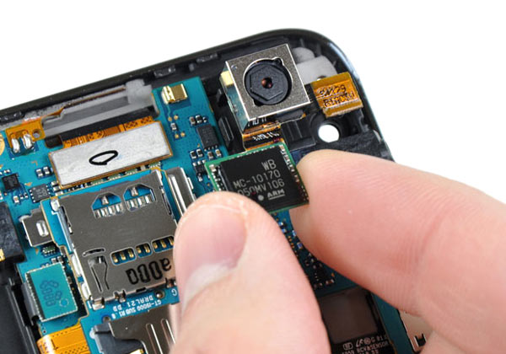
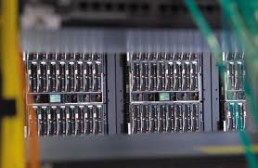

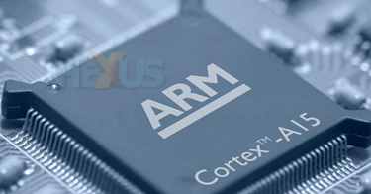
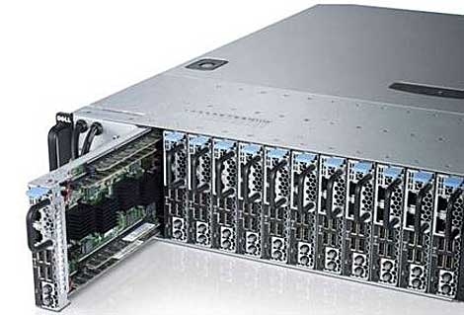

Intel vs ARM
Notes:
Intel – Intel i7 – laptops, PCs, Intel Xeon based server rack, Intel ultrabook convertible, Motorola RAZR, Intle XOLO/Orange
Printer circuit board,
Samsung Galaxy SII, SIII, Note
iphone 5, Google Nexus 10, Samsung’s Chrome Book
BTW,
intel i7 has 4 cores. Some processors have 8, 16 cores. Samsung releasd Exynos 5 – an eight core smart phone!
Any one heard of 5 cores ? Why not tri-core or penta-core systems or hecta-cores ?

Slide 59
Performance Metrics
Purchasing perspective
given a collection of machines, which has the
best performance (speed and/or power consumption)?
least cost?
best cost/performance?
Design perspective
faced with design options, which has the
best performance improvement (speed and/or power consumption)?
least cost?
best cost/performance?
Both require
basis for comparison
metric for evaluation
Our goal is to understand what factors in the architecture contribute to overall system performance and the relative importance (and cost) of these factors
Notes:
Or smallest/lightest
Most reliable/durable (in space)

Slide 60
Throughput versus Response Time
Response time (execution time) – the time between the start and the completion of a task
Important to individual users
Throughput (bandwidth) – the total amount of work done in a given time
Important to data center managers
Will need different performance metrics as well as a different set of applications to benchmark embedded and laptop computers, which are more focused on response time, versus servers, which are more focused on throughput
Notes:
Job completion time. Or, Job turn around time.
Throughput. How efficient my data center is working. Put yourself in the shoes of an entrepreneur. You have a startup and you are expecting your customers to submit a job.
Overprovision for worst case traffic;; ➔ mainly for flash crowd.
It boils down to this trade off : are you willing to provide higher bandwidth (meaning less throughput) as the cost of (power+cooling+maintenance) for customers to have really fast response time, or, are you going to be very conservative and aim for maximum throughput at the cost of losing customers ?
This is the decision that major companies – google, amazon, facebook, Microsoft Azure

Slide 61
Defining (Speed) Performance
To maximize performance, need to minimize execution time
performance_{X} = 1 / execution_time_{X}
If X is n times faster than Y, then
performance_{X} execution_time_{Y}
-------------------- = --------------------- = n
performance_{Y} execution_time_{X}
Decreasing response time almost always improves throughput
Notes:
Increasing performance requires decreasing execution time
If exe time = 10 secs.
Perfx = 1/10 = 0.1
If exe time = 20 secs/
Perfy = 1/20 = 0.05
Perfx/perfy = 0.1/0.05 = 2
Exey/exex = 20/10 = 2
Improve performance = increase the perf = make the system faster.
Improve execution time = decrease the execution time = making the system faster.

Slide 62
A Relative Performance Example
If computer A runs a program in 10 seconds and computer B runs the same program in 15 seconds, how much faster is A than B?

Slide 63
Relative Performance Example
If computer A runs a program in 10 seconds and computer B runs the same program in 15 seconds, how much faster is A than B?
We know that A is n times faster than B if
performance_{A} execution_time_{B}
-------------------- = --------------------- = n
performance_{B} execution_time_{A}
The performance ratio is
15
------ = 1.5
10
So A is 1.5 times faster than B

Slide 64
Measuring Execution Time
Elapsed time
Total response time, including all aspects
Processing, I/O, OS overhead, idle time
Determines system performance
CPU time
Time spent processing a given job
Discounts I/O time, other jobs’ shares
Comprises user CPU time and system CPU time
Different programs are affected differently by CPU and system performance

Slide 65
CPU Clocking
Operation of digital hardware governed by a constant-rate clock
Clock period
Clock (cycles)
Data transfer and computation
Update state
Clock period (cycle): duration of a clock cycle
E.g., 250ps = 0.25ns = 250×10^{–12}s
Clock frequency (rate): cycles per second
E.g., 4.0GHz = 4000MHz = 4.0×10⁹Hz
Notes:
1 sec = 1 hz
0.1 sec = 10hz
.25ns = 1/0.25*10^-9 = 4*10^9Hz = 4Ghz
Rising edge, falling edge.
5stage execution : Called multiple cycle execution.
What is single cycle execution ? Not used.

Slide 66
Review: Machine Clock Rate
Clock rate (clock cycles per second in MHz or GHz) is inverse of clock cycle time (clock period)
CC = 1 / CR
one clock period
10 nsec clock cycle => 100 MHz clock rate
5 nsec clock cycle => 200 MHz clock rate
2 nsec clock cycle => 500 MHz clock rate
1 nsec (10⁻⁹) clock cycle => 1 GHz (10⁹) clock rate
500 psec (10⁻¹²) clock cycle => 2 GHz clock rate
250 psec clock cycle => 4 GHz clock rate
200 psec clock cycle => 5 GHz clock rate
Notes:
A clock cycle is the basic unit of time to execute one operation/pipeline stage/etc.

Slide 67
Performance Factors
CPU execution time (CPU time) – time the CPU spends working on a task (not including time waiting for I/O or running other programs)
CPU execution time # CPU clock cycles
= x clock cycle time
for a program for a program
or
CPU execution time # CPU clock cycles for a program
= -------------------------------------------
for a program clock rate
Can improve performance by reducing either the length of the clock cycle (increasing clock rate) or the number of clock cycles required for a program
The architect must often trade off clock rate against the number of clock cycles for a program
Notes:
Many techniques that decrease the number of clock cycles also increase the clock cycle time

Slide 68
Improving Performance Example
A program runs on computer A with a 2 GHz clock in 10 seconds. What clock rate must a computer B run at to run this program in 6 seconds? Unfortunately, to accomplish this, computer B will require 1.2 times as many clock cycles as computer A to run the program.
Notes:
For class handout

Slide 69
Improving Performance Example
A program runs on computer A with a 2 GHz clock in 10 seconds. What clock rate must computer B run at to run this program in 6 seconds? Unfortunately, to accomplish this, computer B will require 1.2 times as many clock cycles as computer A to run the program.
CPU time_{A} CPU clock cycles_{A}
= -------------------------------
clock rate_{A}
CPU clock cycles_{A} = 10 sec x 2x10⁹ cycles/sec = 20 x 10⁹ clock cycles
CPU time_{B} 1.2 x 20 x 10⁹ clock cycles
= -------------------------------------
clock rate_{B}
clock rate_{B} 1.2 x 20 x 10⁹ cycles
= ------------------------------- = 4 GHz
6 seconds
Notes:
For lecture

Slide 70
Clock Cycles per Instruction
Not all instructions take the same amount of time to execute
One way to think about execution time is that it equals the number of instructions executed multiplied by the average time per instruction
# CPU clock cycles # Instructions Average clock cycles
= x
for a program for a program per instruction
Clock cycles per instruction (CPI) – the average number of clock cycles each instruction takes to execute
A way to compare three different implementations of the same ISA
 | Computer_{A} | Computer_{B}
CPI | 2 | 1.2

Slide 71
THE Performance Equation
Our basic performance equation is then
CPU time = Instruction_count x CPI x clock_cycle
or
Instruction_count x CPI
CPU time = -----------------------------------------------
clock_rate
This equation separate the three key factors that affect performance
Can measure the CPU execution time by running the program
The clock rate is usually given
Can measure overall instruction count by using profilers/ simulators without knowing all of the implementation details
CPI varies by instruction type and ISA implementation for which we must know the implementation details
Notes:
Note that instruction count is dynamic – i.e., its not the number of lines in the code, but THE NUMBER OF INSTRUCTIONS EXECUTED
CPI → varies with ISA
With same ISA, with different architecture;

Slide 72
Using the Performance Equation
Computers A and B implement the same ISA. Computer A has a clock cycle time of 250 ps and an average CPI of 2.0 for some program and computer B has a clock cycle time of 500 ps and an average CPI of 1.2 for the same program. Which computer is faster and by how much?
Notes:
For class handout

Slide 73
Using the Performance Equation
Computers A and B implement the same ISA. Computer A has a clock cycle time of 250 ps and an average CPI of 2.0 for some program and computer B has a clock cycle time of 500 ps and an average CPI of 1.2 for the same program. Which computer is faster and by how much?
Each computer executes the same number of instructions, I, so
CPU time_{A} = I x 2.0 x 250 ps = 500 x I ps
CPU time_{B} = I x 1.2 x 500 ps = 600 x I ps
Clearly, A is faster … by the ratio of execution times
performance_{A} execution_time_{B} 600 x I ps
------------------- = --------------------- = ---------------- = 1.2
performance_{B} execution_time_{A} 500 x I ps
Notes:
For lecture

Slide 74
Average (Effective) CPI
Computing the overall average CPI is done by looking at the different types of instructions and their individual cycle counts and averaging
n
Overall effective CPI = Σ (CPI_{i} x IC_{i})
i = 1
Where IC_{i} is the count (percentage) of the number of instructions of class i executed
CPI_{i} is the number of clock cycles per instruction for that instruction class
n is the number of instruction classes
The overall effective CPI varies by instruction mix – a measure of the dynamic frequency of instructions for one or many programs

Slide 75
A Simple Performance Tradeoff Example
Op | Freq | CPI_{i} | Freq x CPI_{i}
ALU | 50% | 1 | .
Load | 20% | 5
Store | 10% | 3
Branch | 20% | 2
 |  |  | Σ =
How much faster would the machine be if a better data cache reduced the average load time to 2 cycles?
How does this compare with using branch prediction to shave a cycle off the branch time?
What if two ALU instructions could be executed at once?

Slide 76
A Simple Performance Tradeoff Example
Op | Freq | CPI_{i} | Freq x CPI_{i}
ALU | 50% | 1
Load | 20% | 5
Store | 10% | 3
Branch | 20% | 2
 |  |  | Σ =
.5
1.0
.3
.4
.5
.4
.3
.4
.5
1.0
.3
.2
.25
1.0
.3
.4
2.2
1.6
2.0
1.95
How much faster would the machine be if a better data cache reduced the average load time to 2 cycles?
How does this compare with using branch prediction to shave a cycle off the branch time?
What if two ALU instructions could be executed at once?
CPU time new = 1.6 x IC x CC so 2.2/1.6 means 37.5% faster
CPU time new = 2.0 x IC x CC so 2.2/2.0 means 10% faster
CPU time new = 1.95 x IC x CC so 2.2/1.95 means 12.8% faster
Notes:
For lecture

Slide 77
Determinates of CPU Performance
CPU time = Instruction_count x CPI x clock_cycle
 | Instruction_count | CPI | clock_cycle
Algorithm
Programming language
Compiler
ISA
Notes:
For class handout

Slide 78
Determinates of CPU Performance
CPU time = Instruction_count x CPI x clock_cycle
 | Instruction_count | CPI | clock_cycle
Algorithm
Programming language
Compiler
ISA
X
X
X
X
X
X
X
X
X
Notes:
For lecture
Prog Language – affects IC since statements in the language are translated to processor instructions (which determines IC). May also affect CPI because of its features (e.g., a language with heavy support for data abstractions will require indirect calls (that use higher CPI instructions)
Algorithm – May also affect the CPI by favoring slower or faster instructions, e.g., floating-point which have higher CPIs
Pointers -- are pointers optimal for performance ?
Consider example --
#include <stdio.h>
void my_int_func(int x)
{
printf( "%d\n", x );
}
int main()
{
void (*foo)(int); /* the ampersand is actually optional */
Call 100 times foo = &my_int_func;
return 0;
}
Correspoding assembler instructions:
=➔
// Direct call do-it-many-times
call 0x12345678
// Indirect call do-it-many-times
call dword ptr [0x67890ABC]
Compiler : mov eax, 0x12345678
Of course, there's always a question of whether your compiler is smart enough to optimize things like that...

Slide 79
Workloads and Benchmarks
Benchmarks – a set of programs that form a “workload” specifically chosen to measure performance
SPEC (System Performance Evaluation Cooperative) creates standard sets of benchmarks starting with SPEC89. SPEC CPU2006 consists of 12 integer benchmarks (CINT2006) and 17 floating-point benchmarks (CFP2006).
www.spec.org
There are also benchmark collections for power workloads (SPECpower_ssj2008), for mail workloads (SPECmail2008), for multimedia workloads (mediabench), …

Slide 80
SPEC CINT2006 on Barcelona (CC = 0.4 x 10⁻⁹)
Name | ICx10⁹ | CPI | ExTime | RefTime | SPEC ratio
perl | 2,118 | 0.75 | 637 | 9,770 | 15.3
bzip2 | 2,389 | 0.85 | 817 | 9,650 | 11.8
gcc | 1,050 | 1.72 | 724 | 8,050 | 11.1
mcf | 336 | 10.00 | 1,345 | 9,120 | 6.8
go | 1,658 | 1.09 | 721 | 10,490 | 14.6
hmmer | 2,783 | 0.80 | 890 | 9,330 | 10.5
sjeng | 2,176 | 0.96 | 837 | 12,100 | 14.5
libquantum | 1,623 | 1.61 | 1,047 | 20,720 | 19.8
h264avc | 3,102 | 0.80 | 993 | 22,130 | 22.3
omnetpp | 587 | 2.94 | 690 | 6,250 | 9.1
astar | 1,082 | 1.79 | 773 | 7,020 | 9.1
xalancbmk | 1,058 | 2.70 | 1,143 | 6,900 | 6.0
Geometric Mean |  |  |  |  | 11.7
Notes:
Not number of lines in a program.. But instr count. But, mcf – high because of v high memory operations.
Same number of IC, but diff CPI – because of difference in ratio of types of instructions and data access patterns (cache misses)
Perl – interpreted string processing
Bzip2 – block-sorting compression
Gcc – GNU C compiler
Mcf – combinatorial optimization
Go – Go came (AI)
Hmmer – search gene sequence
Sjeng – chess game (AI)
Libquantum – quantum computer simulation
H264avc – video compression
Omnetpp – discrete event simulation library
Astar – games/path finding
Xalancbmk – XML parsing

Slide 81
Comparing and Summarizing Performance
How do we summarize the performance for benchmark set with a single number?
First the execution times are normalized giving the “SPEC ratio” (bigger is faster, i.e., SPEC ratio is the inverse of execution time)
The SPEC ratios are then “averaged” using the geometric mean (GM)
n
GM = n Π SPEC ratio_{i}
i = 1
Guiding principle in reporting performance measurements is reproducibility – list everything another experimenter would need to duplicate the experiment (version of the operating system, compiler settings, input set used, specific computer configuration (clock rate, cache sizes and speed, memory size and speed, etc.))

Slide 82
Pittfall: Amdahl’s Law
Used to determine the maximum expected improvement to overall system performance when only part of the system is improved
How much faster must the multiplier be to get a 2x performance improvement overall if multiplies account for 20 seconds of the of the 100 second run time?
Corollary: Make the common case fast
Notes:
100/2 (2x faster) is 50 == 20 seconds/n + 80 seconds (everything but the multiplies)
-30 == 80/n CAN’T BE DONE
If the rest are adds, then we can improve the add operations as:
50 == 80/n + 20
30 == 80/n, so n = 80/30 so 2.67 times faster

Slide 83
Amdahl's Law
Speedup due to enhancement E:
ExTime w/o E Performance w/ E
Speedup w/ E = ------------------- = -------------------------
ExTime w/ E Performance w/o E
Suppose that enhancement E accelerates a fraction F (F <1) of the task by a factor S (S>1) and the remainder of the task is unaffected then,
ExTime w/ E = ExTime w/o E X ((1-F) + F/S)
Speedup w/ E = 1 / ((1-F) + F/S)

Slide 84
Example: Amdahl’s Law
Consider an enhancement which runs 20 times faster but which is only usable 25% of the time.
Speedup with E = 1/(.75 + .25/20) = 1.31
What if the enhancement is only usable 20% of the time?
Speedup with E = 1/(.80 + .20/20) = 1.23
What if its usable only 15% of the time?
Speedup with E = 1/(.85 + .15/20) = 1.17
Law of diminishing returns!!!

Slide 85
Fallacy: Lowest Power at (Near) Idle
Look back at the X4 (Barcelona) benchmark
At 100% load: 295W
At 50% load: 246W (83%)
At 10% load: 180W (61%)
A Google data center
Mostly operates at a 10% to 50% load
At 100% load less than 1% of the time
Data centers should be designed to make the power proportional to the load
“Energy Proportional Computing,” Barroso and Hӧlzle, IEEE Computer Magazine, Dec 2007
Try to design servers so that they consume 10% of peak power when running at 10% workload levels, etc.

Slide 86
Pitfall: Using MIPS as a Performance Metric
MIPS: Millions of Instructions Per Second
Faster machines have higher MIPS rating
What companies advertise (and easy to calculate), but doesn’t account for
Differences in ISAs between computers
Differences in complexity between instructions
MIPS varies between programs on the same computer (thus, a computer cannot have a single MIPS rating) !
Notes:
Note we are using only two of the three performance factors (IC not there in the final formula). Problems with MIPS
MIPS specifies instruction execution rate but does not take into account capabilities on the instructions. IC will differ between two different ISAs
MIPS varies between programs on the same computer, since they can (and will) have different average CPIs (depending on how many instructions they have in each class for each program), e.g., look at CPIs for Barcelona
If a new program executes more instructions, but each instruction is faster (smaller CPI), the MIPS can vary independently from performance!

Slide 87
Summary: Evaluating ISAs
Design-time metrics
Can it be implemented, in how long, at what cost?
Can it be programmed? Ease of compilation?
Static Metrics
How many bytes does the program occupy in memory?
Dynamic Metrics
How many instructions are executed? How many bytes does the processor fetch to execute the program?
How many clocks are required per instruction?
How "lean" (fast) a clock is practical?
Best Metric: Time to execute the program!
CPI
depends on the instructions set, the processor organization, and compilation techniques.
Inst. Count
Cycle Time

